Slide 1
Neural Networks Semester 1 Practical works for GRIAT RCSE master program Teacher: Makhmutova Alisa Zufarovna AZMakhmutova@kai.ru

Slide 2
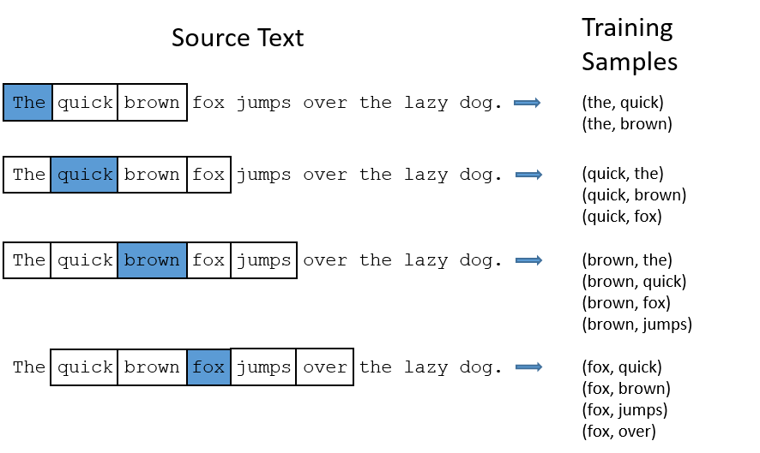
Sequence of data
Often the initial data for solving our problem are sequences. It may be temporary rows (changes in stock prices, sensor readings), naturally occurring sequences with dependent elements (natural language sentences, human speech in recognition) —a word, any data where adjacent points depend on each other, and this dependence cannot be ignored.
KNRTU-KAI | TU ILMENAU | Neural Networks

Slide 3
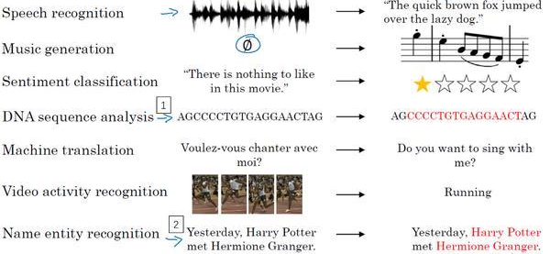
Sequence data examples

Slide 4
Main types of machine learning tasks associated with sequences
one-to-one
one-to-many
many-to-one
many-to many
synchronized many-to-many
Tasks with sequences (from left to right): 1 - one input, one output; 2 - one input, sequence of outputs; 3 - a sequence of inputs, one output; 4 - a sequence of inputs, then a sequence of outputs; 5 - synchronized sequences of inputs and outputs
KNRTU-KAI | TU ILMENAU | Neural Networks
Notes:
one input, one output (one-to-one); here not actually the sequence, we just have to independently process each element of the inputs and get the corresponding output, no hidden states are transferred anywhere; however, note that working with sequences, when windows are processed independently, fits into this scheme, just the inputs will turn out quite strongly dependent;
one input, sequence of outputs (one-to-many); here we must "unwrap" the input, which itself does not have the structure of a sequence, into a sequence of outputs; for example, annotation of pictures represents such a task: a picture at the entrance, a text at the output (sequence);
a sequence of inputs, one output (many-to-one); any type of sequence classification task fits into this type of task; for example, a sentiment analysis: according to this text (that is, a sequence) to issue, it is colored positively or negatively;
a sequence of inputs, then a sequence of outputs (many-to many); here we are talking about "collapse" the input sequence, encode it with some hidden state, and then "expand" this hidden state back into a completely different sequence; for example, according to this general scheme, machine translation systems (input - sentence in one language, output - on another) and interactive systems (input - a replica of the interlocutor, exit - their own replica) work;
synchronized sequences of inputs and outputs (synchronized many-to-many); here you need to label each element of the sequence with your own label, it makes sense also to transfer some hidden state to the next time step; For example, imagine that we need to mark the video stream, in which each subsequent frame, of course, is a separate image, but it is usually very similar to the previous and next.

Slide 5
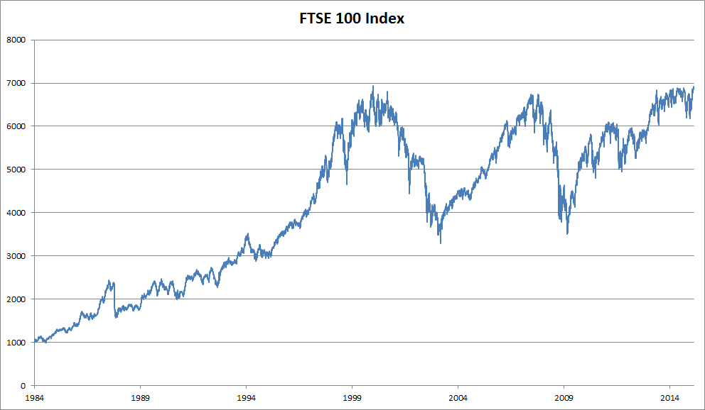

Statistical Tools
FTSE 100 index over about 30 years

Slide 6
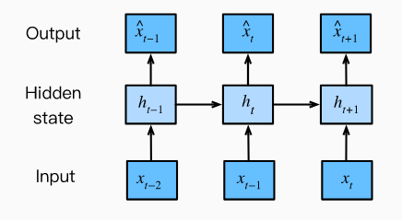

Autoregressive Models
In an autoregression model, we forecast the variable of interest using a linear combination of past values of the variable. The term autoregression indicates that it is a regression of the variable against itself.

Slide 7
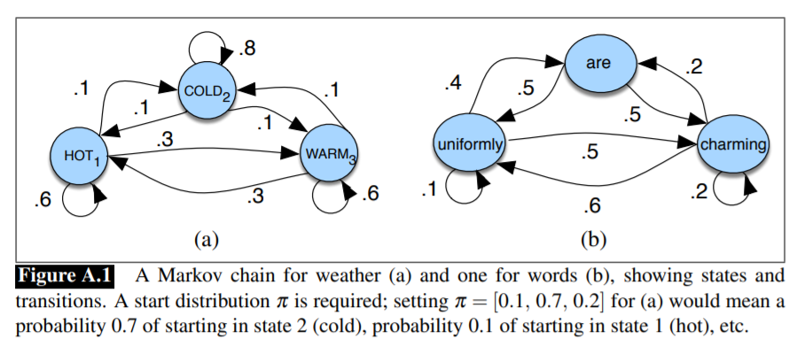
Markov Models
A Markov chain makes a very strong assumption that if we want to predict the future in the sequence, all that matters is the current state.
A hidden Markov model (HMM) allows us to talk about both observed events Hidden Markov model (like words that we see in the input) and hidden events (like part-of-speech tags) that we think of as causal factors in our probabilistic model.

Slide 8
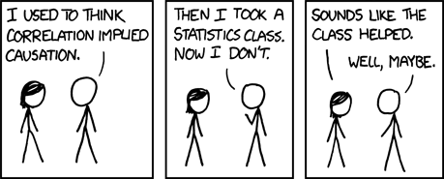
Causality
Sequence models require specialized statistical tools for estimation. Two popular choices are autoregressive models and latent-variable autoregressive models.
For causal models (e.g., time going forward), estimating the forward direction is typically a lot easier than the reverse direction.

Slide 9
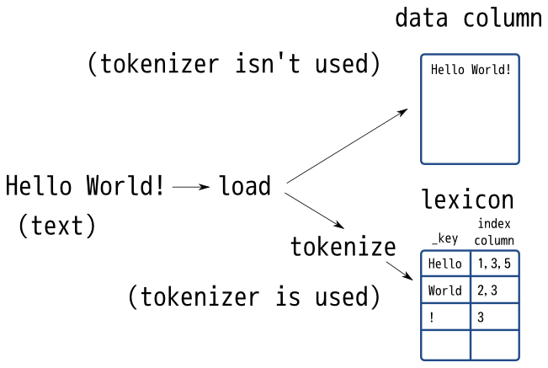
Text Preprocessing
Text is an important form of sequence data.
To preprocess text, we usually:
split text into tokens,
build a vocabulary to map token strings into numerical indices,
convert text data into token indices for models to manipulate.

Slide 10
Language Models
Language modeling (LM) is the use of various statistical and probabilistic techniques to determine the probability of a given sequence of words occurring in a sentence.
Language models analyze bodies of text data to provide a basis for their word predictions.
We need to calculate the probability of words and the conditional probability of a word given the previous few words
The probability formulae that involve one, two, and three variables are typically referred to as unigram, bigram, and trigram models, respectively.

Slide 11
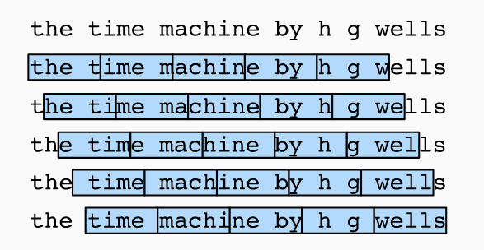
Therefore, we can start with a random offset to partition a sequence to get both coverage and randomness. In the following, it will be described how to accomplish this for both random sampling and sequential partitioning strategies.

Slide 12
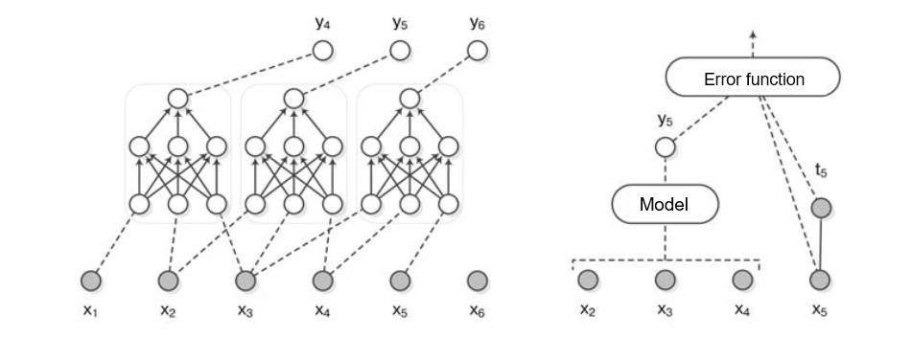







Network for sequence processing
$$l −some length of the sequence$$
$$x_{n −some element of the sequence}$$
$$x_{1}, x_{2}…x_{n−2},x_{n−1}$$
$$x_{n}=f(x_{n−1},…x_{n−l})$$
$$y_{4}=f(x_{1}, x_{2},x_{3})$$
$$y_{5}=f(x_{2}, x_{3},x_{4})$$
$$y_{6}=f(x_{3}, x_{4},x_{5})$$
The architecture of a neural network with a fixed history size.
Left: the same neural network is applied consistently to input windows.
Right: the result of the neural network is compared with the next
sequence element
KNRTU-KAI | TU ILMENAU | Neural Networks

Slide 13
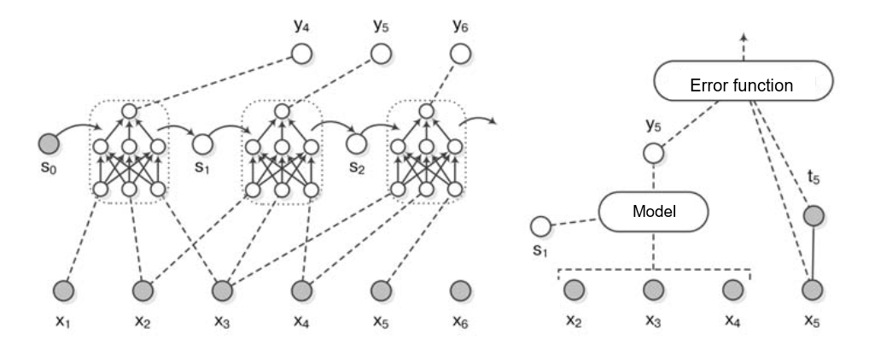
Recurrent neural network (RNN)
“Ordinary” neural networks have a fixed number of inputs and perceive each of them as independent. In recurrent networks, the communication between neurons can go not only from the lower layer to the upper one, but also from the neuron to “itself”, more precisely, to the previous value of this neuron itself or other neurons of the same layer.
This is exactly what makes it possible to reflect the dependence of a variable on its values at different points in time: the neuron learns to use not only the current input and what the neurons of the previous levels did to it, but also what happened to itself and, possibly, other neurons at the previous inputs .
KNRTU-KAI | TU ILMENAU | Neural Networks

Slide 14
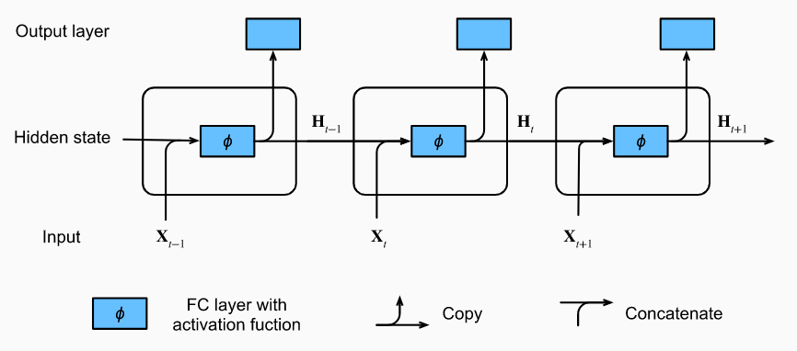
Recurrent neural network (RNN)

Slide 15
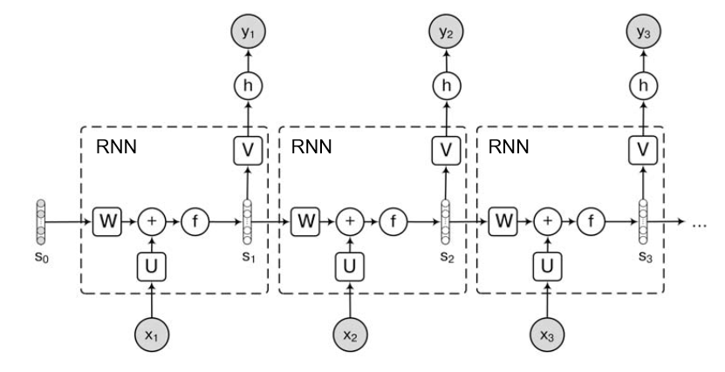
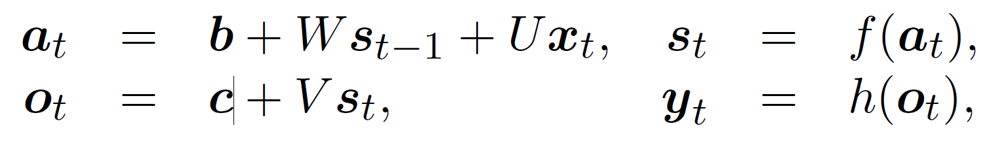
Recurrent neural network (RNN)
W weights matrix for transition between hidden states, U weights matrix for inputs, and V for outputs
f - is the non-linearity of the actual recurrent network (usually sigmoid, tanh or ReLU), and h is the function with which the answer is obtained (for example, softmax)
We can use perplexity to evaluate the quality of language models.
KNRTU-KAI | TU ILMENAU | Neural Networks

Slide 16
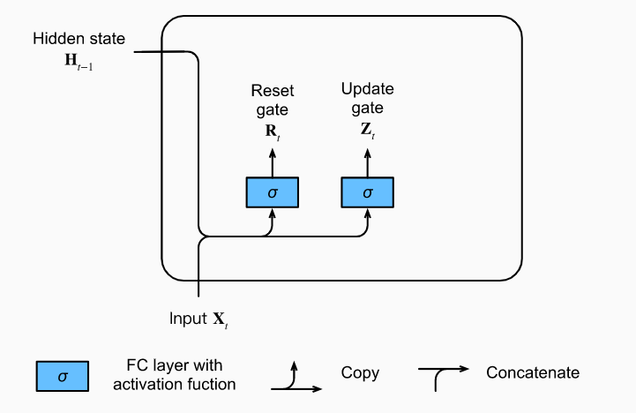
Gated Recurrent Units (GRU)
memory cell
mechanism for skipping
resetting our internal state representation
A reset gate would allow us to control how much of the previous state we might still want to remember. An update gate would allow us to control how much of the new state is just a copy of the old state.

Slide 17
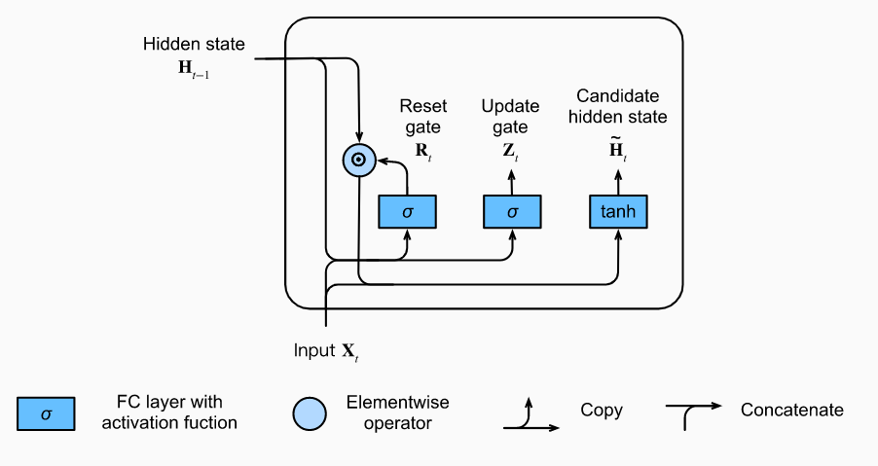
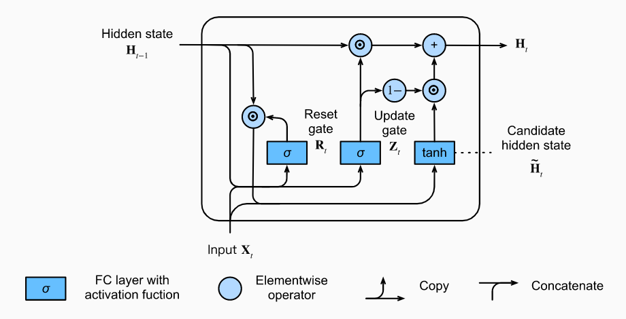
Gated Recurrent Units (GRU)
In summary, GRUs have the following two distinguishing features:
Reset gates help capture short-term dependencies in sequences.
Update gates help capture long-term dependencies in sequences.

Slide 18
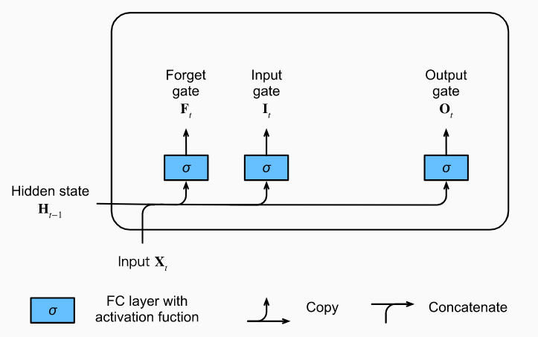
LSTM - Long Short-Term Memory

Slide 19
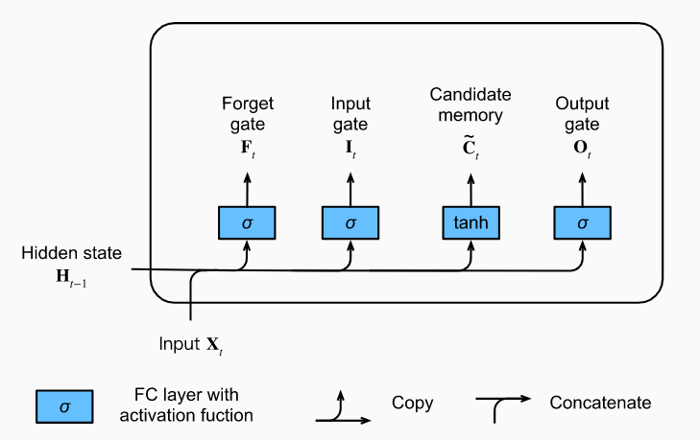
LSTM - Long Short-Term Memory

Slide 20
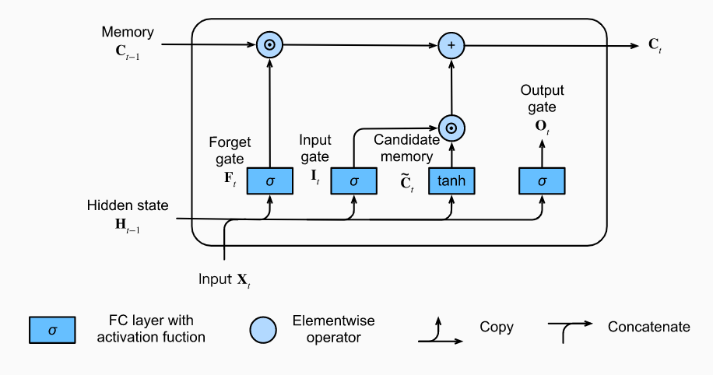
LSTM - Long Short-Term Memory

Slide 21
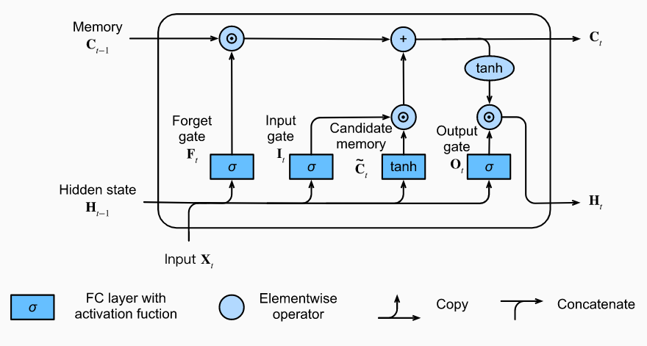
LSTM - Long Short-Term Memory
Whenever the output gate approximates 1 we effectively pass all memory information through to the predictor, whereas for the output gate close to 0 we retain all the information only within the memory cell and perform no further processing.

Slide 22
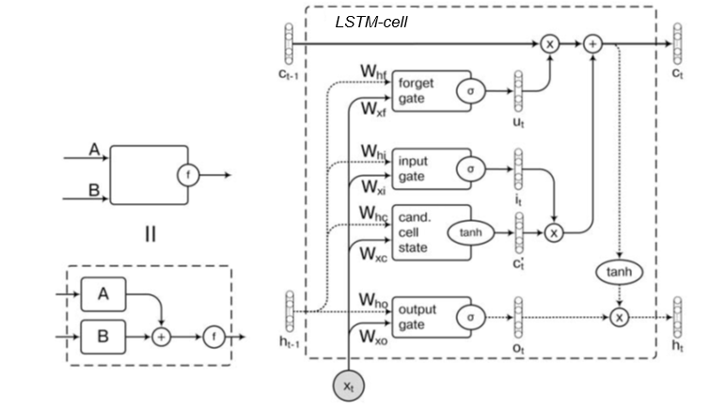
LSTM - Long Short-Term Memory
There are three main types of nodes in LSTM, which are called gates: input gate, forget gate and output gate, as well as the recurrent cell itself with a hidden state. In addition, so-called peepholes are often added to LSTM — additional connections that increase the connectivity of the model.
KNRTU-KAI | TU ILMENAU | Neural Networks

Slide 23
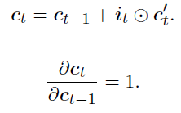
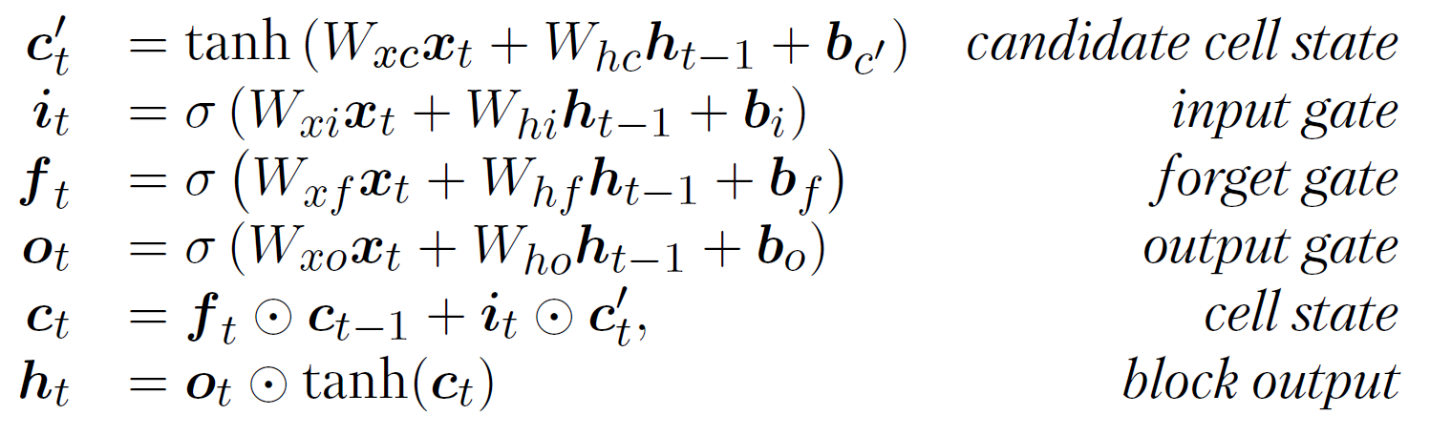
LSTM - Long Short-Term Memory
There are three main types of nodes in LSTM, which are called gates: input gate, forget gate and output gate, as well as the recurrent cell itself with a hidden state. In addition, so-called peepholes are often added to LSTM — additional connections that increase the connectivity of the model.
Imagine LSTM without a forgetting gate.
This effect, in which there is no non-linearity in the recursive calculation of the
cell state, is called constant error carousel in the network;
KNRTU-KAI | TU ILMENAU | Neural Networks

Slide 24
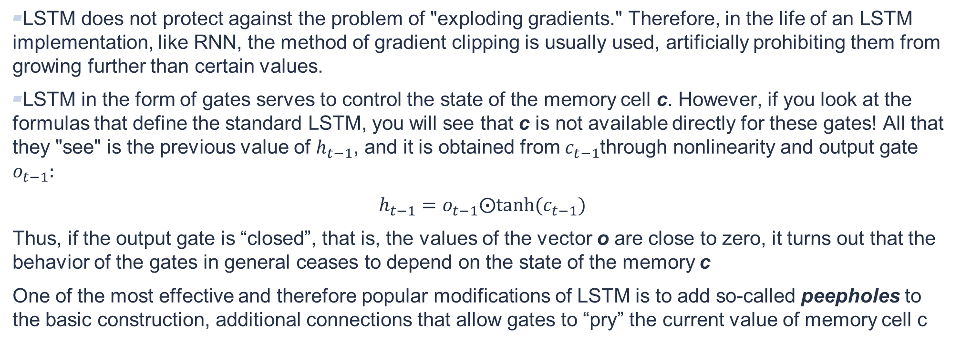
LSTM - Long Short-Term Memory
LSTM does not protect against the problem of "exploding gradients." Therefore, in the life of an LSTM implementation, like RNN, the method of gradient clipping is usually used, artificially prohibiting them from growing further than certain values.
LSTM in the form of gates serves to control the state of the memory cell c. However, if you look at the formulas that define the standard LSTM, you will see that c is not available directly for these gates! All that they "see" is the previous value of $h_{t−1}$, and it is obtained from $c_{t−1}$through nonlinearity and output gate $o_{t−1}:$
$$h_{t−1}=o_{t−1}⨀tanh⁡(c_{t−1})$$
Thus, if the output gate is “closed”, that is, the values of the vector o are close to zero, it turns out that the behavior of the gates in general ceases to depend on the state of the memory c
One of the most effective and therefore popular modifications of LSTM is to add so-called peepholes to the basic construction, additional connections that allow gates to “pry” the current value of memory cell c
KNRTU-KAI | TU ILMENAU | Neural Networks

Slide 25
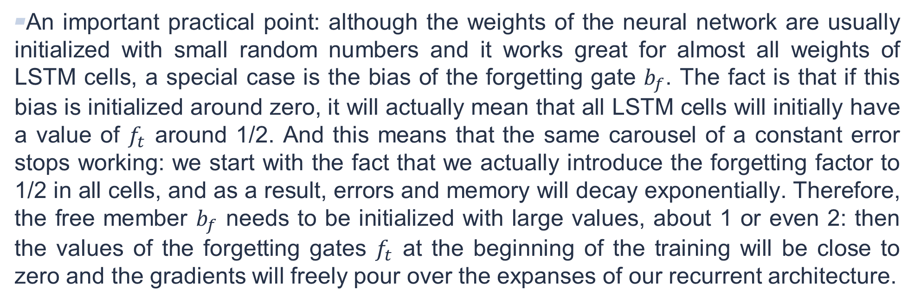
LSTM - Long Short-Term Memory
An important practical point: although the weights of the neural network are usually initialized with small random numbers and it works great for almost all weights of LSTM cells, a special case is the bias of the forgetting gate $b_{f}$. The fact is that if this bias is initialized around zero, it will actually mean that all LSTM cells will initially have a value of $f_{t}$ around 1/2. And this means that the same carousel of a constant error stops working: we start with the fact that we actually introduce the forgetting factor to 1/2 in all cells, and as a result, errors and memory will decay exponentially. Therefore, the free member $b_{f}$ needs to be initialized with large values, about 1 or even 2: then the values of the forgetting gates $f_{t}$ at the beginning of the training will be close to zero and the gradients will freely pour over the expanses of our recurrent architecture.
KNRTU-KAI | TU ILMENAU | Neural Networks

Slide 26
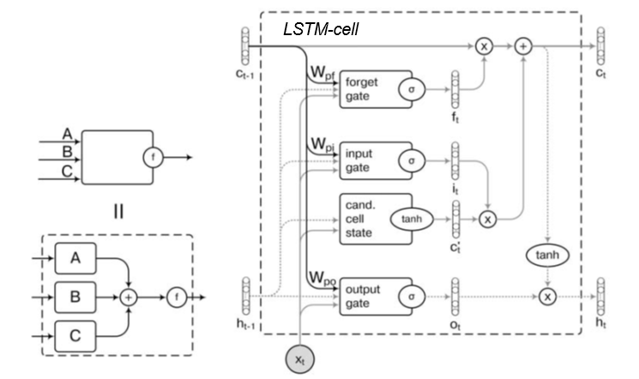
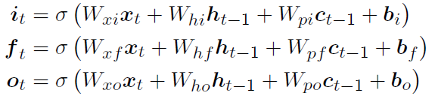
LSTM - Long Short-Term Memory
KNRTU-KAI | TU ILMENAU | Neural Networks

Slide 27
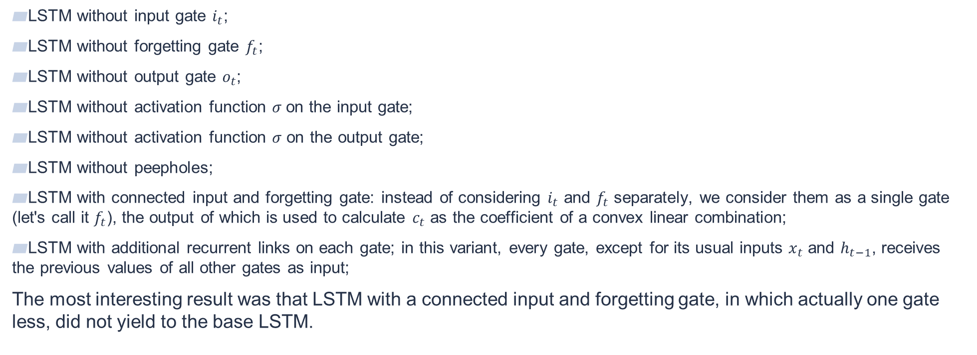
LSTM - Long Short-Term Memory
LSTM without input gate $i_{t}$;
LSTM without forgetting gate $f_{t}$;
LSTM without output gate $o_{t}$;
LSTM without activation function $σ$on the input gate;
LSTM without activation function $σ$ on the output gate;
LSTM without peepholes;
LSTM with connected input and forgetting gate: instead of considering $i_{t}$ and $f_{t}$ separately, we consider them as a single gate (let's call it $f_{t}$), the output of which is used to calculate $c_{t}$ as the coefficient of a convex linear combination;
LSTM with additional recurrent links on each gate; in this variant, every gate, except for its usual inputs $x_{t}$ and $h_{t−1}$, receives the previous values of all other gates as input;
The most interesting result was that LSTM with a connected input and forgetting gate, in which actually one gate less, did not yield to the base LSTM.
KNRTU-KAI | TU ILMENAU | Neural Networks

Slide 28
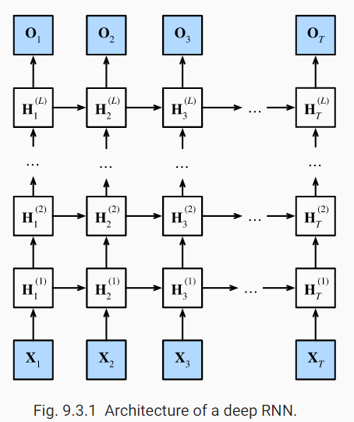
Deep Recurrent Neural Networks
In deep RNNs, the hidden state information is passed to the next time step of the current layer and the current time step of the next layer.
There exist many different flavors of deep RNNs, such as LSTMs, GRUs, or vanilla RNNs. Conveniently these models are all available as parts of the high-level APIs of deep learning frameworks.
Initialization of models requires care. Overall, deep RNNs require considerable amount of work (such as learning rate and clipping) to ensure proper convergence.

Slide 29
Bidirectional RNN
The motivation is to get a state that reflects the context both on the left and on the right for each element of the sequence.
KNRTU-KAI | TU ILMENAU | Neural Networks

Slide 30
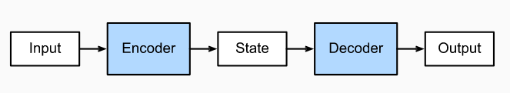
Encoder-Decoder Architecture
Это кошка
It is a cat
C'est un chat

Slide 31
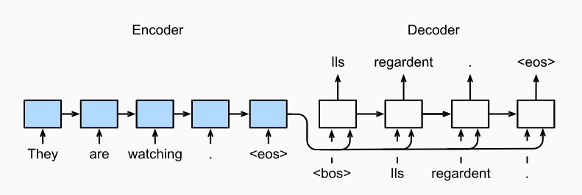
Sequence to Sequence Learning

Slide 32
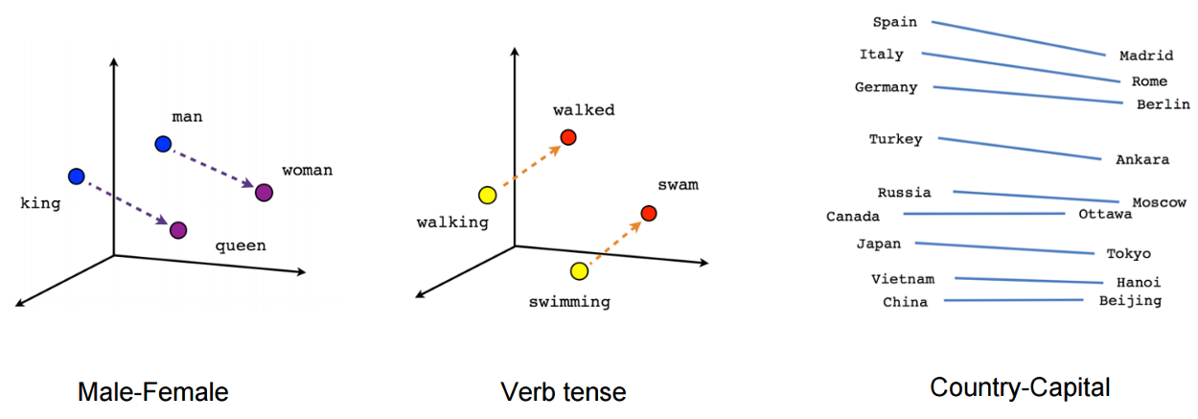
Sequence to Sequence Learning

Slide 33
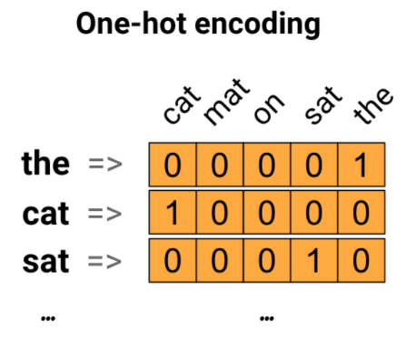
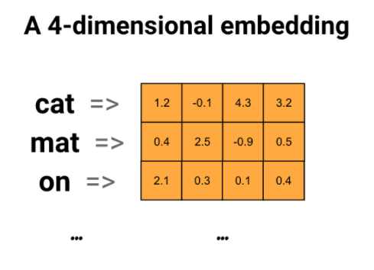
Sequence to Sequence Learning

Slide 34
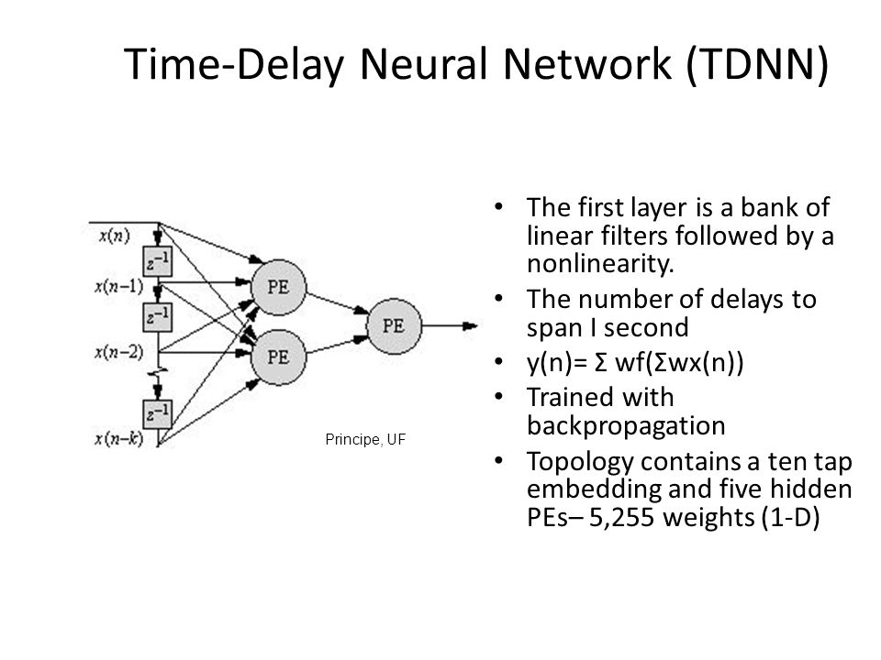
Time delay neural network (TDNN)
Time delay neural network (TDNN) is a multilayer artificial neural network architecture whose purpose is to 1) classify patterns with shift-invariance, and 2) model context at each layer of the network.
The point is that the network inputs, arriving as a sequence, are fed to the network input not one by one, but sequentially with delays; in the case of TDNN, only that the delays may be different, and in some cases even automatically tuned.
KNRTU-KAI | TU ILMENAU | Neural Networks

Slide 35
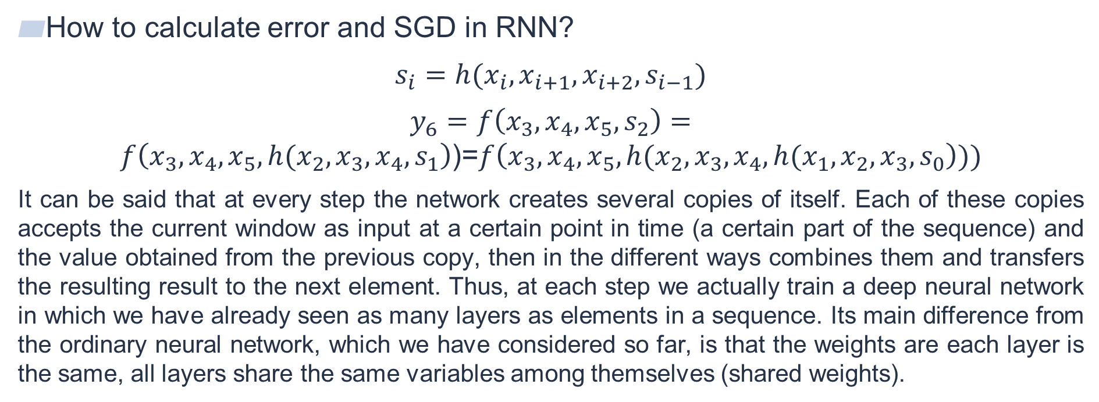
Recurrent neural network (RNN)
How to calculate error and SGD in RNN?
$$s_{i}=h(x_{i}, x_{i+1},x_{i+2},s_{i−1})$$
$y_{6}=f\left(x_{3},x_{4},x_{5},s_{2}\right)=f\left(x_{3},x_{4},x_{5},h(x_{2},x_{3},x_{4},s_{1}\right)$)=$f\left(x_{3},x_{4},x_{5},h(x_{2},x_{3},x_{4},h(x_{1},x_{2},x_{3}, s_{0}\right)))$
It can be said that at every step the network creates several copies of itself. Each of these copies accepts the current window as input at a certain point in time (a certain part of the sequence) and the value obtained from the previous copy, then in the different ways combines them and transfers the resulting result to the next element. Thus, at each step we actually train a deep neural network in which we have already seen as many layers as elements in a sequence. Its main difference from the ordinary neural network, which we have considered so far, is that the weights are each layer is the same, all layers share the same variables among themselves (shared weights).
KNRTU-KAI | TU ILMENAU | Neural Networks

Slide 36
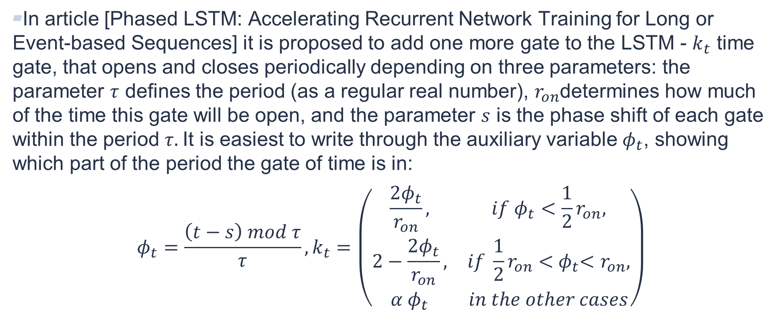
Phased LSTM
In article [Phased LSTM: Accelerating Recurrent Network Training for Long or Event-based Sequences] it is proposed to add one more gate to the LSTM - $k_{t}$ time gate, that opens and closes periodically depending on three parameters: the parameter $τ$ defines the period (as a regular real number), $r_{on}$determines how much of the time this gate will be open, and the parameter $s$ is the phase shift of each gate within the period $τ.$It is easiest to write through the auxiliary variable $φ_{t}$, showing which part of the period the gate of time is in:
$$φ_{t}=\frac{\left(t−s\right) mod τ}{τ},k_{t}=\left(\begin{matrix}\frac{2φ_{t}}{r_{on}}, & if{ φ}_{t}<\frac{1}{2}r_{on}, \\ 2−\frac{2φ_{t}}{r_{on}}, & if \frac{1}{2}r_{on}<{ φ}_{t}<r_{on}, \\ α{ φ}_{t} & in the other cases\end{matrix}\right)$$
KNRTU-KAI | TU ILMENAU | Neural Networks

